Slide 1
Help Wanted Online
A real-time measure of job postings
March 2021
Office of Research
Connecticut Department of Labor
Connecticut Department of Labor – Research Office
200 Folly Brook Blvd.
Wethersfield, CT 06109
Help Wanted Online

Slide 2
What is HWOL?
The Conference Board Help Wanted Online® Data Series (HWOL) measures the number of new, first-time Online job postings and jobs reposted from the previous month for over 50,000 Internet job boards, corporate boards and smaller job sites that serve niche markets and smaller geographic areas.
Connecticut Department of Labor – Research Office
200 Folly Brook Blvd.
Wethersfield, CT 06109
Help Wanted Online

Slide 3
Upcoming Release Dates
Monthly Report:
Wednesday, April 23, 2021
Wednesday, May 26, 2021
Wednesday, June 23, 2021
Weekly New Ads Report:
Updated every Friday
Connecticut Department of Labor – Research Office
200 Folly Brook Blvd.
Wethersfield, CT 06109
Help Wanted Online

Slide 4
Statewide Weekly New Job Ads
Weekly New job postings were 7,465 during the week ending 3/13/21.
Connecticut Department of Labor – Research Office
200 Folly Brook Blvd.
Wethersfield, CT 06109
Help Wanted Online

Slide 5
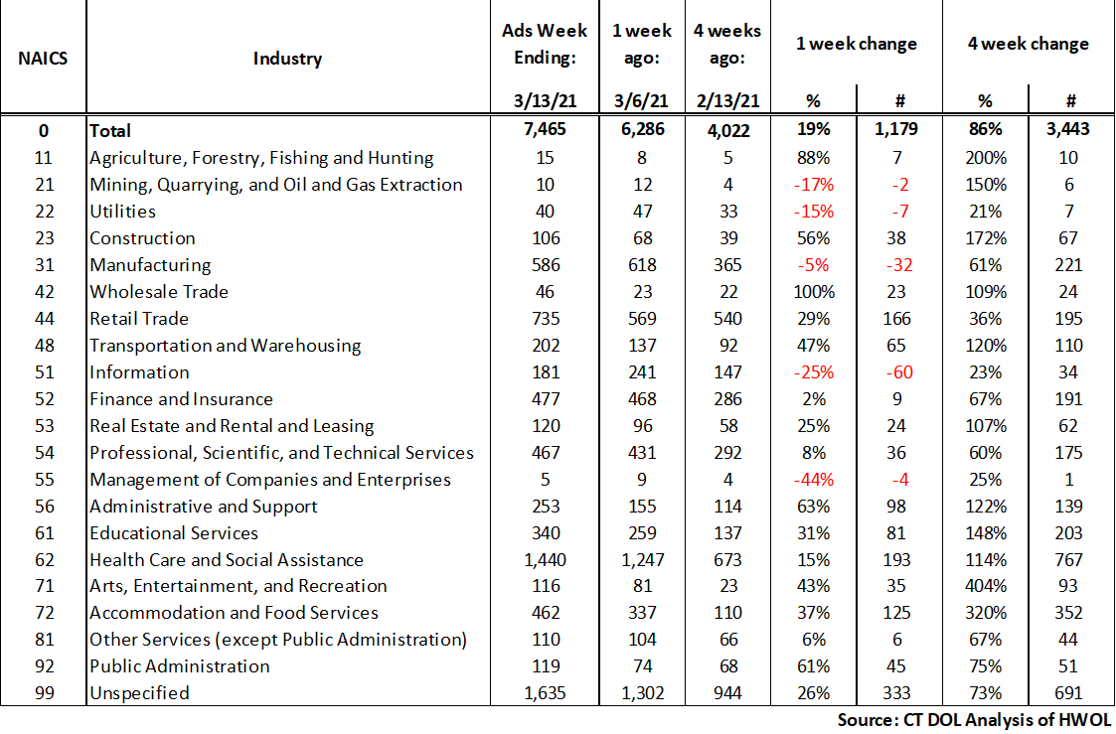
HWOL New Weekly Industry Job Ads – CT Statewide
Connecticut Department of Labor – Research Office
200 Folly Brook Blvd.
Wethersfield, CT 06109
Help Wanted Online

Slide 6
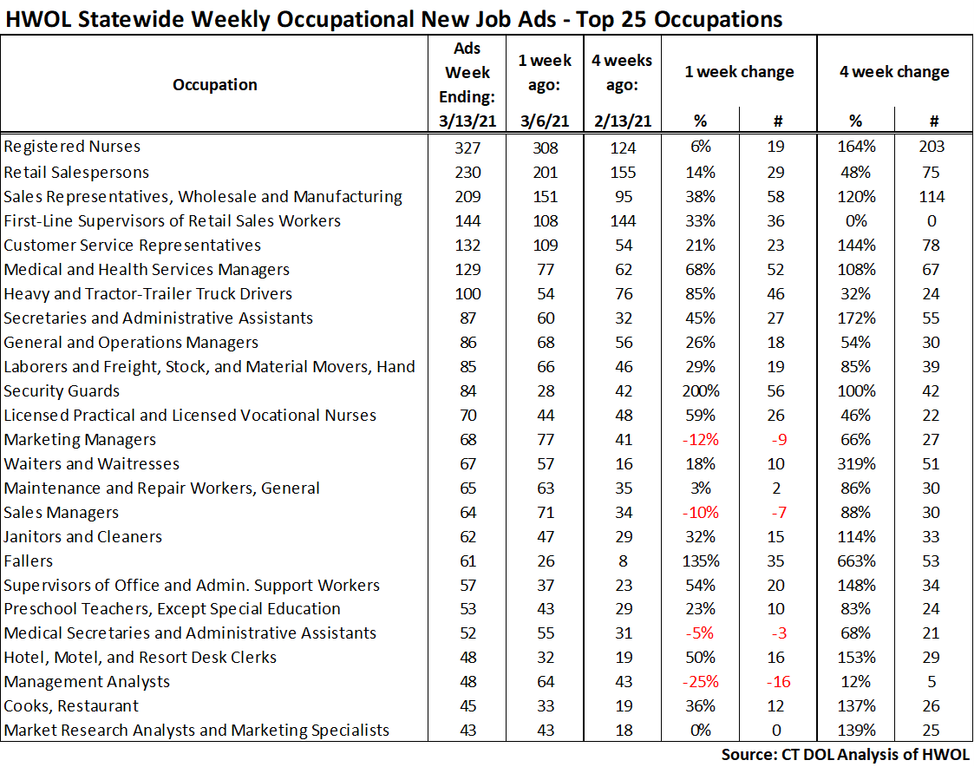
Connecticut Department of Labor – Research Office
200 Folly Brook Blvd.
Wethersfield, CT 06109
Help Wanted Online

Slide 7
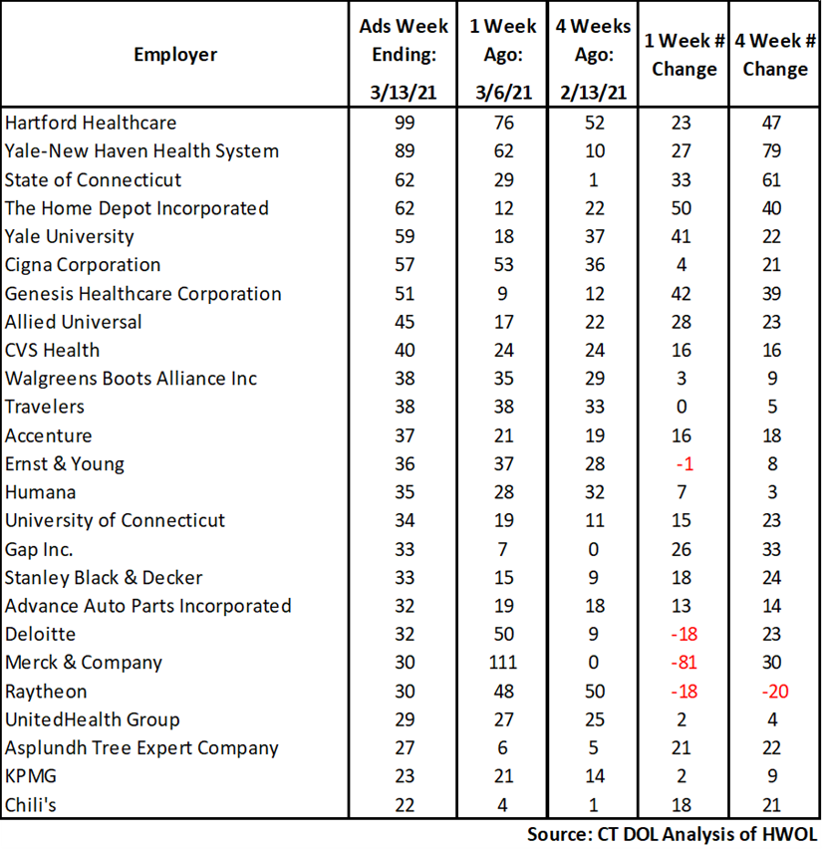
Employers with the Most New Job Postings
Connecticut Department of Labor – Research Office
200 Folly Brook Blvd.
Wethersfield, CT 06109
Help Wanted Online

Slide 8
Monthly HWOL Information
The following pages contain HWOL monthly data for February 2021.
Monthly and weekly job ad information can be found here:
https://www1.ctdol.state.ct.us/lmi/HWOL.asp
Connecticut Department of Labor – Research Office
200 Folly Brook Blvd.
Wethersfield, CT 06109
Help Wanted Online

Slide 9
Statewide Highlights
- Total postings in Connecticut was 51,685 in February 2021.
-Industry sectors with the most job postings were Health Care and Social Assistance (10,405 postings), Retail Trade (6,295 postings), Finance and Insurance (4,197 posting), and Manufacturing (4,084 postings).
-Occupations with the most postings were Registered Nurses (2,056 postings), Retail Salesperson (1,646 postings), Sales Representatives, Wholesale and Manufacturing (1,379 postings) Supervisors of Retail Sales Workers (1,347 postings) and Customer Service Representatives (964 postings).
Connecticut Department of Labor – Research Office
200 Folly Brook Blvd.
Wethersfield, CT 06109
Help Wanted Online

Slide 10
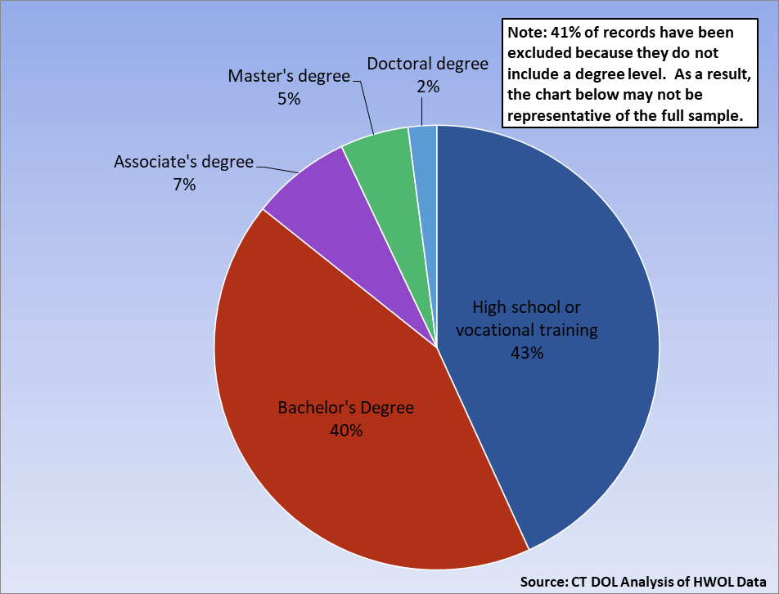
Connecticut Job Ads by Educational Requirements
Connecticut Department of Labor – Research Office
200 Folly Brook Blvd.
Wethersfield, CT 06109
Help Wanted Online

Slide 11
Top Certifications in Connecticut Job Ads
Connecticut Department of Labor – Research Office
200 Folly Brook Blvd.
Wethersfield, CT 06109
Help Wanted Online

Slide 12
Top Skills in Connecticut Job Ads
Connecticut Department of Labor – Research Office
200 Folly Brook Blvd.
Wethersfield, CT 06109
Help Wanted Online

Slide 13
Top Skills by Industry in Connecticut Job Ads
Connecticut Department of Labor – Research Office
200 Folly Brook Blvd.
Wethersfield, CT 06109
Help Wanted Online

Slide 14
Top Skills by Industry in Connecticut Job Ads (Continued)
Connecticut Department of Labor – Research Office
200 Folly Brook Blvd.
Wethersfield, CT 06109
Help Wanted Online

Slide 15
Connecticut Department of Labor – Research Office
200 Folly Brook Blvd.
Wethersfield, CT 06109
Help Wanted Online

Slide 16
Connecticut Employers with the Most Job Ads
Connecticut Department of Labor – Research Office
200 Folly Brook Blvd.
Wethersfield, CT 06109
Help Wanted Online

Slide 17
Connecticut Occupations with the Most Job Ads
Connecticut Department of Labor – Research Office
200 Folly Brook Blvd.
Wethersfield, CT 06109
Help Wanted Online

Slide 18
Labor Market Area Data
Labor Market Area Highlights
Job Ads by Industry
Job Ads by Location
Employers With The Most Job Ads
Occupations With The Most Job Ads
Connecticut Department of Labor – Research Office
200 Folly Brook Blvd.
Wethersfield, CT 06109
Help Wanted Online

Slide 19
Labor Market Area Highlights
Connecticut Department of Labor – Research Office
200 Folly Brook Blvd.
Wethersfield, CT 06109
Help Wanted Online

Slide 20
Connecticut Department of Labor – Research Office
200 Folly Brook Blvd.
Wethersfield, CT 06109
Help Wanted Online

Slide 21
Hartford LMA Job Ads by Location
Connecticut Department of Labor – Research Office
200 Folly Brook Blvd.
Wethersfield, CT 06109
Help Wanted Online

Slide 22
Hartford LMA Employers
with the Most Job Ads
Hartford Healthcare
Cigna Corporation
CVS Health
Ernst & Young
Travelers
Trinity Health
University of Connecticut
Allied Universal
The Hartford Financial Group
The Home Depot Incorporated
Accenture
Petco
Community Health Center, Inc.
Lowe's Companies, Inc
Guidehouse
Hospital For Special Care
Black & Veatch
William W. Backus Hospital
Whole Foods Market, Inc.
State of Connecticut
Raytheon
UnitedHealth Group
Eastern Connecticut Health Network
Deloitte
Walgreens Boots Alliance Inc
Stanley Black & Decker
Dattco Travel
EverSource
Genesis Healthcare Corporation
Pearson
Eversource Energy
Fiserv
Wheeler Clinic
Brookdale Senior Living
Advance Auto Parts Incorporated
ECHN
Voya Investment Management LLC
TJX Companies, Inc.
Connecticut Department of Labor – Research Office
200 Folly Brook Blvd.
Wethersfield, CT 06109
Help Wanted Online

Slide 23
Hartford LMA Occupations
with the Most Job Ads
Connecticut Department of Labor – Research Office
200 Folly Brook Blvd.
Wethersfield, CT 06109
Help Wanted Online

Slide 24
Connecticut Department of Labor – Research Office
200 Folly Brook Blvd.
Wethersfield, CT 06109
Help Wanted Online
24

Slide 25
Bridgeport Stamford LMA Job Ads by Location
Connecticut Department of Labor – Research Office
200 Folly Brook Blvd.
Wethersfield, CT 06109
Help Wanted Online

Slide 26
Bridgeport Stamford LMA Employers
with the Most Job Ads
Lockheed Martin Corporation
Stamford Hospital
Charter Communications
Gartner Incorporated
Yale-New Haven Health System
St Vincent's Medical Center
ASML
Walgreens Boots Alliance Inc
Thermo Fisher Scientific Inc
Norwalk Public School District
Petco
Intuit
Henkel
UnitedHealth Group
Benchmark Senior Living
People's United Bank
Sacred Heart University
State Farm Insurance Companies
Massage Envy
Humana
Deloitte
Boehringer Ingelheim
Whole Foods Market, Inc.
Griffin Health
Hartford Healthcare
CVS Health
The Home Depot Incorporated
Synchrony
Allied Universal
Griffin Health Services Corporation
Compass Group North America
Apple Inc.
NBC
KPMG
State of Connecticut
Asml United States Incorporated
Lowe's Companies, Inc
Center For Discovery
Connecticut Department of Labor – Research Office
200 Folly Brook Blvd.
Wethersfield, CT 06109
Help Wanted Online

Slide 27
Bridgeport Stamford LMA Occupations
with the Most Job Ads
Connecticut Department of Labor – Research Office
200 Folly Brook Blvd.
Wethersfield, CT 06109
Help Wanted Online

Slide 28
Connecticut Department of Labor – Research Office
200 Folly Brook Blvd.
Wethersfield, CT 06109
Help Wanted Online

Slide 29
New Haven LMA Job Ads by Location
Connecticut Department of Labor – Research Office
200 Folly Brook Blvd.
Wethersfield, CT 06109
Help Wanted Online

Slide 30
New Haven LMA Employers
with the Most Job Ads
Yale-New Haven Health System
Medtronic
Walgreens Boots Alliance Inc
Avangrid
Alexion Pharmaceuticals
Gaylord Specialty Healthcare
Quest Diagnostics Incorporated
Petco
UnitedHealth Group
Lowe's Companies, Inc
Masonicare Corporation
Advance Auto Parts Incorporated
Burns & McDonnell
Fair Haven Community Health Care
Compass Group North America
Sodexo
Thermo Fisher Scientific Inc
Aldi
BJ's Wholesale Club, Inc.
Anthem Blue Cross
Yale University
Hartford Healthcare
CVS Health
The Home Depot Incorporated
Genesis Healthcare Corporation
State of Connecticut
Allied Universal
Department of Veterans Affairs
Honeywell
VNA Community Healthcare
Quinnipiac University
O'Reilly Automotive Inc
Carefinders
Burlington
Bozzuto
Dattco Travel
Amazon
McDonald's
Connecticut Department of Labor – Research Office
200 Folly Brook Blvd.
Wethersfield, CT 06109
Help Wanted Online

Slide 31
New Haven LMA Occupations
with the Most Job Ads
Connecticut Department of Labor – Research Office
200 Folly Brook Blvd.
Wethersfield, CT 06109
Help Wanted Online

Slide 32
Connecticut Department of Labor – Research Office
200 Folly Brook Blvd.
Wethersfield, CT 06109
Help Wanted Online

Slide 33
New London LMA Job Ads by Location
Connecticut Department of Labor – Research Office
200 Folly Brook Blvd.
Wethersfield, CT 06109
Help Wanted Online

Slide 34
New London LMA Employers
with the Most Job Ads
Pfizer
Lowe's Companies, Inc
Walgreens Boots Alliance Inc
State of Connecticut
Mohegan Sun
CVS Health
Sonalysts Incorporated
Allied Universal
Nordson Corporation
Hubbell Incorporated
Genesis Healthcare Corporation
William W. Backus Hospital
National Vision Incorporated
TVCCA
Amentum
Area Wide Protective
Hersha Hospitality Management LP
Advantage Sales & Marketing
Thames Valley Council For Community Action
General Dynamics
CDS Corporate
The Home Depot Incorporated
Groton Public Schools
Compass Group North America
Aveanna Healthcare
Atria Senior Living
Masonicare Corporation
Community Health Center, Inc.
Sea Research Foundation
United States Foods
Petco
Backus Hospital
Advance Auto Parts Incorporated
Bob's Discount Furniture
Eurofins Scientific
Care At Home
Atx Learning
Liberty Bank
Connecticut Department of Labor – Research Office
200 Folly Brook Blvd.
Wethersfield, CT 06109
Help Wanted Online

Slide 35
New London LMA Occupations
with the Most Job Ads
Connecticut Department of Labor – Research Office
200 Folly Brook Blvd.
Wethersfield, CT 06109
Help Wanted Online

Slide 36
Connecticut Department of Labor – Research Office
200 Folly Brook Blvd.
Wethersfield, CT 06109
Help Wanted Online

Slide 37
Danbury LMA Job Ads by Location
Connecticut Department of Labor – Research Office
200 Folly Brook Blvd.
Wethersfield, CT 06109
Help Wanted Online

Slide 38
Danbury LMA Employers
with the Most Job Ads
Genesis Healthcare Corporation
The Home Depot Incorporated
Hologic Incorporated
Maplewood At Stony Hill LLC
Allied Universal
Walgreens Boots Alliance Inc
Cds Corporate
Apple Inc.
Advantage Sales & Marketing
Emerson Electric Company
UnitedHealth Group
Danbury Public Schools
DRS Technologies Incorporated
Union Savings Bank
Compass Group North America
Schaeffler Group
Praxair
Luk Usa Llc
Select Medical
Whole Foods Market, Inc.
Western Connecticut Health Network
Petco
Floor Decor
CVS Health
Entegris Incorporated
Realogy Franchise Group LLC
Newtown Savings Bank
Leonardo Drs, Inc
BJ's Wholesale Club, Inc.
State Farm Insurance Companies
Western Connecticut Healthcare
Quest Diagnostics Incorporated
Lowe's Companies, Inc
Closet Factory
Newtown Public School District
Senior Lifestyle Corporation
Advance Auto Parts Incorporated
Odyssey Logistics Technology
Connecticut Department of Labor – Research Office
200 Folly Brook Blvd.
Wethersfield, CT 06109
Help Wanted Online

Slide 39
Danbury LMA Occupations
with the Most Job Ads
Connecticut Department of Labor – Research Office
200 Folly Brook Blvd.
Wethersfield, CT 06109
Help Wanted Online

Slide 40
Connecticut Department of Labor – Research Office
200 Folly Brook Blvd.
Wethersfield, CT 06109
Help Wanted Online

Slide 41
Waterbury LMA Employers
with the Most Job Ads
Waterbury Hospital
Compass Group North America
Hoffman Auto Group
Raytheon
Advance Auto Parts Incorporated
Genesis Healthcare Corporation
Paraco Gas Corporation
Petco
Domino's Pizza
O'Reilly Automotive Inc
Dollar Tree
Burlington
Pep Boys
Aldi
Restaurant Depot
National Vision Incorporated
GameStop Incorporated
Applied Materials
UnitedHealth Group
Trinity Health
Mercy Medical Center Clinton
CVS Health
Post University
Seasons Hospice & Palliative Care
Intuit
The Home Depot Incorporated
State of Connecticut
Naugatuck Public Schools
Ametek Incorporated
Hartford Healthcare
Gil Foundation Incorporated
Wheeler Clinic
Benchmark Senior Living
Community Health Center, Inc.
Walmart / Sam's
Taft School
Quest Diagnostics Incorporated
Connecticut Department of Labor – Research Office
200 Folly Brook Blvd.
Wethersfield, CT 06109
Help Wanted Online

Slide 42
Waterbury LMA Job Ads by Location
Connecticut Department of Labor – Research Office
200 Folly Brook Blvd.
Wethersfield, CT 06109
Help Wanted Online

Slide 43
Waterbury LMA Occupations
with the Most Job Ads
Connecticut Department of Labor – Research Office
200 Folly Brook Blvd.
Wethersfield, CT 06109
Help Wanted Online

Slide 44
Connecticut Department of Labor – Research Office
200 Folly Brook Blvd.
Wethersfield, CT 06109
Help Wanted Online

Slide 45
Torrington LMA Job Ads by Location
Connecticut Department of Labor – Research Office
200 Folly Brook Blvd.
Wethersfield, CT 06109
Help Wanted Online

Slide 46
Torrington LMA Employers
with the Most Job Ads
Lowe's Companies, Inc
Dymax Corporation
Health Quest
The Hotchkiss School
The Arc Of Litchfield County, Inc
Petco
Charlotte Hungerford Hospital
CVS Health
Alternative Employment Incorporated
Connecticut Junior Republic
William W. Backus Hospital
Intuit
State Farm Insurance Companies
The Arc Of Litchfield County Inc
Crate & Barrel
Compass Group North America
BJ's Wholesale Club, Inc.
Commercial Sewing, Inc
Companions Homemakers Incorporated
Hartford Healthcare
Devereux Advanced Behavioral Health
Mayflower Inn & Spa
Becton Dickinson
OG Industries Incorporated
Walgreens Boots Alliance Inc
State of Connecticut
Roehl Transport
YMCA
McDonald's
Raytheon
Hubbell Incorporated
Quest Diagnostics Incorporated
Community Health Center Association Of Connecticut
Brandywine Living
Xtramart
Union Savings Bank
Schaeffler Group
Connecticut Department of Labor – Research Office
200 Folly Brook Blvd.
Wethersfield, CT 06109
Help Wanted Online

Slide 47
Torrington LMA Occupations
with the Most Job Ads
Connecticut Department of Labor – Research Office
200 Folly Brook Blvd.
Wethersfield, CT 06109
Help Wanted Online

Slide 48
Connecticut Department of Labor – Research Office
200 Folly Brook Blvd.
Wethersfield, CT 06109
Help Wanted Online

Slide 49
Enfield LMA Job Ads by Location
Connecticut Department of Labor – Research Office
200 Folly Brook Blvd.
Wethersfield, CT 06109
Help Wanted Online

Slide 50
Enfield LMA Employers
with the Most Job Ads
Raytheon
C&S Wholesale Grocers
State of Connecticut
Community Health Resources
ShopRite / Wakefern
Walgreens Boots Alliance Inc
FedEx
The Home Depot Incorporated
Safeguard Security
Pinnacle Logistics
Symetra Life Insurance Company
Outback Steakhouse
Intelycare
Enfield School District
Gat Airline Ground Support
Community Health Center, Inc.
Santander
Aspen Dental
Hilton Hotel Corporation
The Lego Group
Advance Auto Parts Incorporated
CVS Health
Allied Universal
Petco
Penske
Allied Community Services Incorporated
Advantage Sales & Marketing
Eppendorf
Reyes Holdings
Burlington
Specialty Printing
Enterprise Rent-A-Car
Collins Aerospace
Cantina Hospitality Llc
Cracker Barrel
TJX Companies, Inc.
Harp Home Services
Hp Hood Incorporated
Connecticut Department of Labor – Research Office
200 Folly Brook Blvd.
Wethersfield, CT 06109
Help Wanted Online

Slide 51
Enfield LMA Occupations
with the Most Job Ads
Connecticut Department of Labor – Research Office
200 Folly Brook Blvd.
Wethersfield, CT 06109
Help Wanted Online

Slide 52
Connecticut Department of Labor – Research Office
200 Folly Brook Blvd.
Wethersfield, CT 06109
Help Wanted Online

Slide 53
Danielson LMA Job Ads by Location
Connecticut Department of Labor – Research Office
200 Folly Brook Blvd.
Wethersfield, CT 06109
Help Wanted Online

Slide 54
Danielson-Northeast LMA Employers
with the Most Job Ads
Day Kimball Healthcare
Lowe's Companies, Inc
Quality Homemakers Incorporated
McDonald's
Generations Family Health Center
Walgreens Boots Alliance Inc
Hartford Healthcare
Citizens Financial Group
PepsiCo Inc.
Aveanna Healthcare
Petco
Compass Group North America
Amazon
United Natural Foods
State of Connecticut
Spirol International Corporation
Sonoco Products Company
Natchaug Hospital Incorporated
Thornfield Hall
Staples
Rogers Corporation
Advance Auto Parts Incorporated
CVS Health
Dattco Travel
Danaher Corporation
Morgan Corporation
Utilities Service
Capstone Logistics Group
Asplundh Tree Expert Company
Pomfret School
Putnam Plastics
Dattco
United Services Incorporated
Aldi
Mars Incorporated
Thompson Public Schools
United States Postal Service
Berkshire Bank
Connecticut Department of Labor – Research Office
200 Folly Brook Blvd.
Wethersfield, CT 06109
Help Wanted Online

Slide 55
Danielson-Northeast LMA Occupations
with the Most Job Ads
Connecticut Department of Labor – Research Office
200 Folly Brook Blvd.
Wethersfield, CT 06109
Help Wanted Online

Slide 56
All advertisement data used in this publication is from the Conference Board’s Help Wanted Online data series.
For more information or data requests, contact
Matthew Krzyzek in the Office of Research at the Department of Labor.
(860) 263-6287
Matthew.Krzyzek@ct.gov
For more Connecticut Labor Market Information visit:
www.ctdol.state.ct.us/lmi
https://www.facebook.com/ctlmi
Twitter: @DOL_Research
Connecticut Department of Labor – Research Office
200 Folly Brook Blvd.
Wethersfield, CT 06109
Help Wanted Online

